Slide 1


Online Shopping Cart
Prepared By:-
Student 1 Name: Meet Thakor
Roll no:249
Enrollment No:2021002170110199
Batch: 6A Branch:CE
Student 2 Name: Pranshu Shah
Roll no:233
Enrollment No:2021002170110141
Batch: 6A Branch:CE
Student 3 Name: Harshil Patel
Roll no:232
Enrollment No:2021002170110104
Batch: 6A Branch:CE
Student 4 Name:Mittal Desai
Roll no:239
Enrollment No:2021002170110024
Batch: 6A Branch:CE

Slide 2
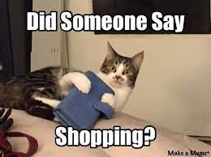

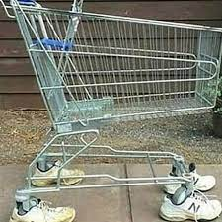
Introduction:
Shopping is one of the most essential part of our daily life. We’re using different types of shops to buy different kind of things everyday.
Today our life is divided into two parts :
Physical life : We met everyone physically.
Virtual life : We met people on a virtual world called ‘Internet’.

Slide 3
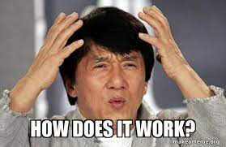
How it works;
First you enter your name.
Then 3 options pops up of Headphones,Shoes,Mobiles.
Then we select our choice .
Then we select our product from our choice.
After selecting you can either add or delete items to your shopping list.
And at last you get your final bill with your products in it.

Slide 4
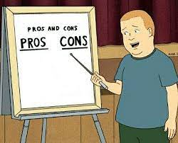
Pros and Cons:
Pros-
Convenience
Greater selection
Easy to access
Cons-
Can be expensive
Leads to loner time to wait
Privacy concerns

Slide 5


